Slide 1
SWIFT ACT Internship Project
ELECTRIC WATER HEATER

Slide 2
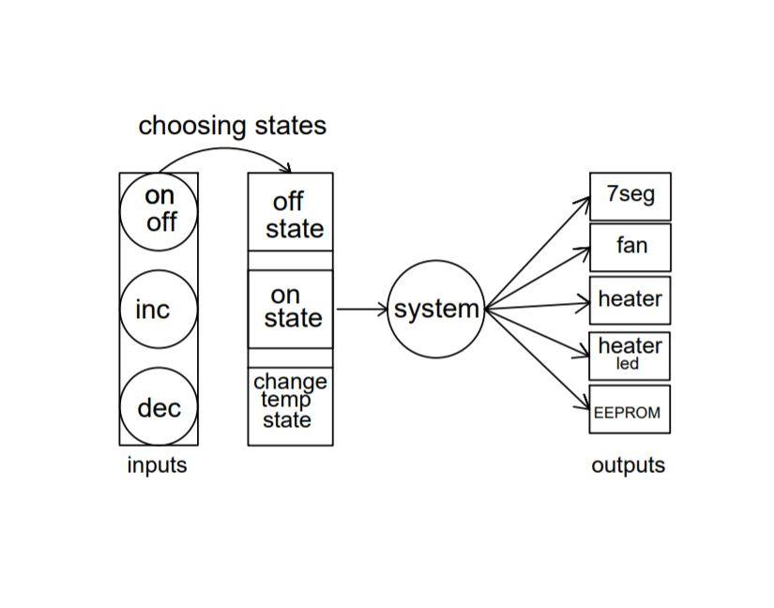
System Design

Slide 3
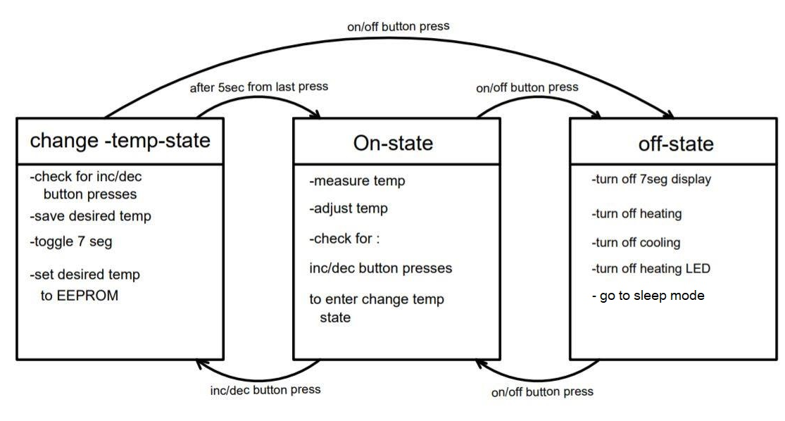
State Diagram

Slide 4
Detailed Design
Buttons
Button_Init
ON_Button_EXTI_Init
UP_Pressed
Down_Pressed
Display
Sev_Seg_Init
Sev_Seg_Write
Sev_Seg_Enable
Sev_Seg_Disable
Sev_Seg_Write_99
Fan
Fan_Init
Fan_Start
Fan_Stop
EEPROM
Includes I2C driver
EEPROM_Init
EEPROM_Write
EEPROM_Read
I2C driver :
I2C_Init
I2C_Hold
I2C_Start
I2C_Repeated_Start
I2C_Stop
I2C_Write_Byte
I2C_Read_Byte
Heater
Heater_Init
Heater_Start
Heater_Stop

Slide 5
Detailed Design “contd.”
LEDs
Heating_LED_Init
Heating_LED_On
Heating_LED_Off
Heating_LED_Toggle
Temp Sensor
Temp_Sensor_ADC_Init
Temp_Sensor_ADC_Read
Main Function :
- Initialize the system
- Check the State
- call the State Task
System
Sytem_Init
Adjust_Temp
Add_New_Temp
Calc_Temp_Avg
State Task Functions
Task_OFF_State
Task_ON_State
Task_ChangeTemp_State

Slide 6
Detailed Design “contd.”
Configurable parameters
MARGIN_TEMP = 1
Should be 5 degree but I used 1 for better performance
MAX_TEMP = 75
MIN_TEMP = 35
INITIAL_DESIRED_TEMP = 60
NUM_OF_TEMP_MEASUREMENTS = 10
DEBOUNCING_INTERVAL = 75 ms “Defined in Buttons.h “
System Interrupts :
External Interrupt (ON/OFF)
Timer1 interrupt
used for Toggling and
Tracking 5 sec delays after last button press
Timer 0 interrupt
used to set a flag each 100ms to Measure the Temprature

Slide 7
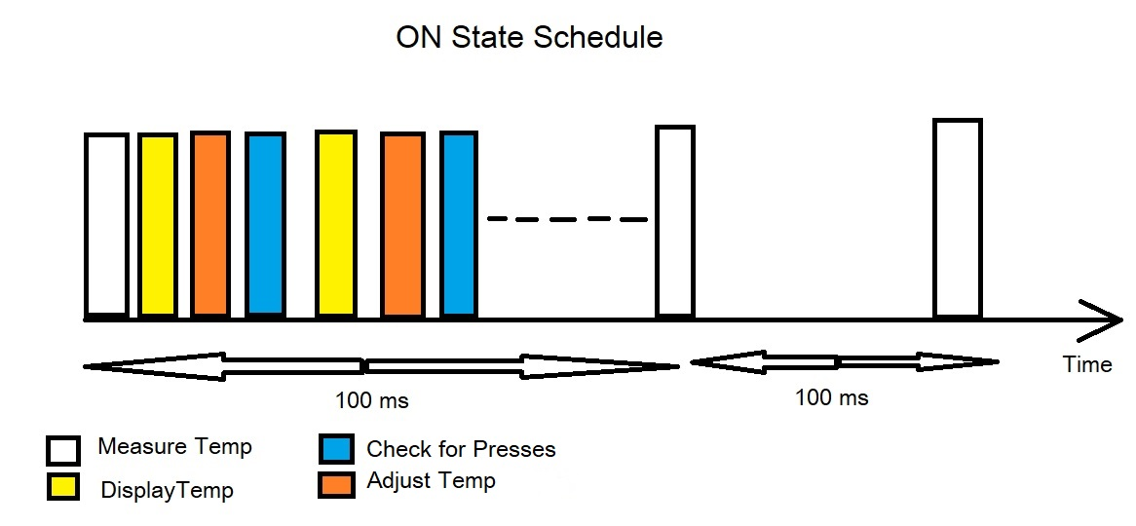
Schedulability Check

